Slide 1
Public Service Grants Best Practices
June 12, 2025
Notes:
Worked in Non-Profit Sector writing grants. Trainings 15 minutes to 1 hour.

Slide 2
Notes:
They if we had any questions.

Slide 3
If you don't know what you don't know, how can you know?
Notes:
I decided to do trainings for every part of the process.
Sharing all the relevant knowledge and explaining why.

Slide 4
Pre-Application
CDBG Committee
Pre-Contract
Technical Assistance
TRAINING
Notes:
2-3 hours in-person

Slide 5
WHY?
Notes:
Pre-Application
Timeline
Understand Grant Requirements/Eligibility
Eligible Activities Matrix Codes
The purpose for collecting information?
Application sections/questions/documents
Scoring criteria
Funding limits
Save everyone’s time—

Slide 6
PROGRAM MANAGEMENT
Acronyms
Subrecipient Defined
Rules and Regulations
Grantee Defined
Program Management
Funding Limitations
National Objectives
Eligible Public Service Activities
Determining Eligibility
Goals and Performance Measures
Program Reports
Notes:
Documentation
Matrix Codes
Beneficiaries' eligibility

Slide 7
I’m sorry, but are you speaking English?

Slide 8
FINANCIAL MANAGEMENT
Internal Controls
Accounting Records
Maintenance of Records
Allowable Costs
Source Documentation
Budget Control
Cash Management
Financial Reporting
Procurement
Records to be Maintained
Notes:
Documentation

Slide 9
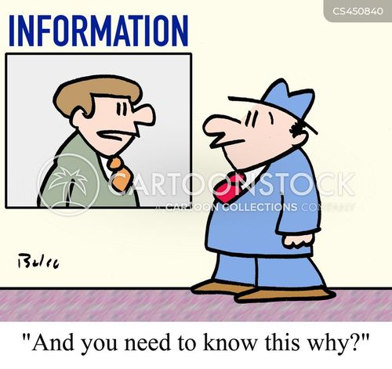
Notes:
Stay off the front page of newspaper
Stay out of jail
Not pay money back

Slide 10
MONITORING PROCESS
Outside Agency Audit
Types of Monitoring
Project Monitoring—As Needed
Desk Review—Monthly
On-site Visits—Annually
Drawdown Requests—Each Submission
General Compliance
Non-Compliance
Corrective Action

Slide 11
SUBRECIPIENT AGREEMENT
Scope of Work
Budget
Applicable Laws, Regulations, and Requirements
Grant Closeout
Post-Award Responsibilities
Conflict of Interest

Slide 12
Peggy Calda
Peggy.calda@wvc-ut.gov
801-963-3280
West Valley City, UT

